Slide 1
JavaScript
& DOM Manipulation
Mohammed Arif
Senior Interactive Developer @ SapientNitro
Twitter@arif_iq
Linkedin: http://in.linkedin.com/in/mohdarif
Blog: http://www.mohammedarif.com

Slide 2
Agenda:
JavaScript As “the Behavior Layer”
JavaScript: What it is and isn't
ECMAScript
JavaScript: Usage
Naming conventions
What is the DOM?

Slide 3
Before We Start!
Important tools to have
    Firebug for Firefox (http://www.getfirebug.com)
    IE Web Developer Toolbar (handy) (http://www.microsoft.com/downloads/details.aspx?familyid=E59C3964-672D-4511-BB3E-2D5E1DB91038&displaylang=en)
    DebugBar for IE (http://www.debugbar.com/download.php)

Slide 4
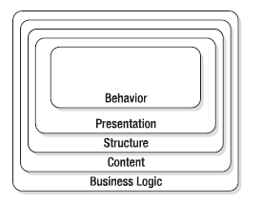
JavaScript As “the Behavior Layer”:
• The behavior layer: Is executed on the client and defines how different elements behave when the user interacts with them (JavaScript or ActionScript for Flash sites).
• The presentation layer: Is displayed on the client and is the look of the web page (CSS, imagery).

Slide 5
• The structure layer: Is converted or displayed by the user agent. This is the markup defining what a certain text or media is (XHTML).
• The content layer: Is stored on the server and consists of all the text, images, and multimedia content that are used on the site (XML, database, media assets).
• The business logic layer (or back end): Runs on the server and determines what is done with incoming data and what gets returned to the user.

Slide 6
JS: What it is and isn’t
NOT Java despite its name
ECMAScript
More than form validation
Client-Side Scripting Language
  Dynamic
  Object-Based (Prototype-Based)
It is an interpreted language

Slide 7

ECMAScript:
ECMAScript is a scripting programming language, standardized by ECMA International in the ECMA-262 specification. The language is widely used on the web, and is often referred to as JavaScript or JScript.
Each browser has its own implementation of the ECMAScript interface, which is then extended to contain the DOM and BOM. There are other languages that also implement and extend ECMAScript such as Windows Scripting Host (WSH), ActionScript in Macromedia Flash, and Nombas ScriptEase.

Slide 8

JS: Usage
Drop this puppy in your page:
<html>
<head>
<title>Example JS Page</title>
  <script language=”JavaScript”>
  <!-- hide from older browsers
    function sayHi() {
    alert(“Hi”);
    }
  //-->
  </script>
        <noscript>
        <p>Your browser doesn’t support JavaScript. If it did support
        JavaScript, you would see this message: Hi!</p>
        </noscript>
</head>
<body>
</body>
</html>
However, noscript is deprecated in XHTML and strict}
HTML, and there is no need for it—if you create JavaScript that is unobtrusive.
Example:

Slide 9
Naming conventions
Camel Notation — the first letter is lowercase and each appended word begins with an uppercase letter. For example:
var myTestValue = 0, mySecondTestValue = “hi”;
Pascal Notation —the first letter is uppercase and each appended word begins with an uppercase letter. For example:
var MyTestValue = 0, MySecondTestValue = “hi”;
Hungarian Type Notation — prepends a lowercase letter (or sequence of lowercase letters) to the beginning of a Pascal Notation variable name to indicate the type of the variable. For example, i means integer and s means string in the following line:
var iMyTestValue = 0, sMySecondTestValue = “hi”;

Slide 10
JS: Literals
The following are literals…each variable is literally the data assigned.
JavaScript does not have strict data types
<script type=“text/javascript”>
var myNumber = 123;
var myString = ‘Bork!’;
var myBoolean = true;
var myFunction = function(){ return ‘hello’;} //anonymous function
var myArray = [1, 2, 3];
</script>

Slide 11
Variables Scope
There are two types of variables:
  Local variables
    Are created within a function
    Only recognized within that function
    Multiple functions can use the same local variable name without error
  Global variables
    Are available everywhere
    Names must be unique
How do you create a local or a global function?
  Created inside a function:
    Declared with “var” it’s local
    Without “var” and it’s global
  Created outside of a function, it’s always global

Slide 12
JS: Objects
Everything in JS is an Object
Those literals can be written:
<script type=“text/javascript”>
var myNumber = new Number(123);
var myString = new String(‘Rayyan’);
var myBoolean = new Boolean(true);
var myFunction = new Function(‘’, “return ‘hello’”);}
var myRegExp = new RegExp(‘bork’);
var myArray = new Array();
myArray[0] = 1;
myArray[1] = 2;
myArray[2] = 3;
var myCarObject = new Object();
myCarObject.color = ‘red’;
myCarObject.tires = 4;
myCarObject.windows = 6;
</script>

Slide 13
JS: Control Structures
if(condition) {
//...
} else {
//...
}
while(condition) {
//...
}
for(var i = 0; i< 10; i++) {
//...
}
for(var element in array_of_elements) {
//...
}
do {
//...
} while(condition);
switch(param) {
case 1:
// if param == 1...
case 'whee':
// if param == 'whee'...
case false:
// if param == false...
default:
// otherwise ...
}
try {
//...
} catch(err) {
//...
}

Slide 14
What is the DOM?
The Document Object Model (DOM) is an application programming interface (API) for HTML as well as XML. The DOM maps out an entire page as a document composed of a hierarchy of nodes.
It alter the appearance & content of a page without reloading the document.
Each part of an HTML or XML page is a derivative of a node. Consider the following HTML page:

Slide 15
DOM == Document Object Model
The DOM is hierarchical
<html>
<head>
<title>Example JS Page</title>
</head>
<body>
<div id=“Rayyan”>
<ul>
<li>Delhi</li>
<li>Mumbai</li>
<li>Chennai</li>
<li>Kolkata</li>
</ul>
</div>
</body>
</html>

Slide 16
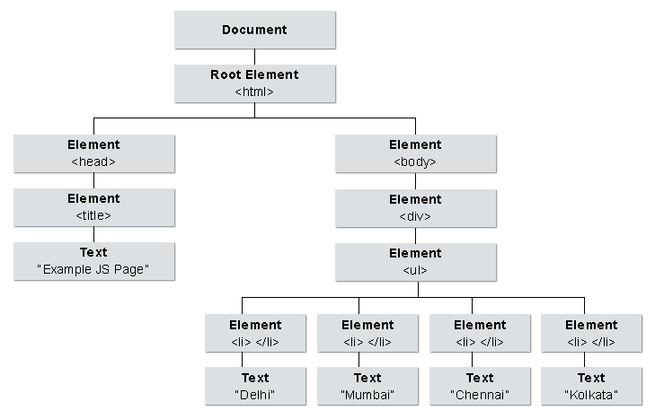
DOM Tree:

Slide 17
Finding DOM Elements
document.getElementById(id)
  returns a specific element
document.getElementsByTagName(DIV)
  returns an array of elements
document.getElementsByName(name)
  returns a collection of objects with the specified NAME

Slide 18
DOM Element Attributes
DOM Attributes
Node Types (12)
nodeName
nodeValue
nodeType
parentNode
childNodes
firstChild
lastChild
previousSibling
nextSibling
attributes
ownerDocument
1 = an HTML element
2 = an element attribute
3 = text
8 = an HTML comment
9 = a document
10 = a document type definition

Slide 19
Manipulating the DOM
Dynamically creating and adding elements
  document.createElement
  appendChild

Slide 20
Events
Mouse
Frame/Object
Form
Click
Dblclick
Mousedown
Mouseup
Mouseover
Mousemove
Mouseout
Load
Unload
Abort
Error
Resize
Scroll
Select
Change
Submit
Reset
Focus
Blur
Keyboard
Keypress
Keydown
Keyup

Slide 21
Event Handlers/Listeners:
With an event handler you can do something with an element when an event occurs: when the user clicks an element, when the page loads, when a form is submitted, etc.
To assign an event handler in JavaScript, you have to get a reference to the object in question and then
assign a function to the corresponding event handler property like this:
var oDiv = document.getElementById(“div1”);
oDiv.onclick = function () {
alert(“I was clicked”);
};
&
<div onclick=”alert(‘I was clicked’)”></div>

Slide 22
Internet Explorer
In IE, every element and window object has two methods: attachEvent()
and detachEvent().
var fnClick = function () {
alert(“Clicked!”);
};
var oDiv = document.getElementById(“div”);
oDiv.attachEvent(“onclick”, fnClick); //add the event handler
//do some other stuff here
oDiv.detachEvent(“onclick”, fnClick); //remove the event handler

Slide 23
DOM (Mozilla, Opera, etc.)
The DOM methods addEventListener() and removeEventListener() accomplish the assignment and removal of event handlers. These methods, unlike IE, take three parameters: the event name, the function to assign, and whether the handler should be used for the bubbling or capture phase. If the handler is to be used in the capture phase, the third parameter is true; for the bubbling phase, it is false.
Here’s the general syntax:
[Object].addEventListener(“name_of_event”, fnHandler, bCapture);
[Object].removeEventListener(“name_of_event”, fnHandler, bCapture);
example

Slide 24
References
JavaScript
http://www.w3schools.com/JS/default.asp
http://www.mozilla.org/js/scripting/
http://www.quirksmode.org/resources.html
DOM
http://www.w3schools.com/htmldom/
http://www.quirksmode.org/dom/intro.html
http://www.javascriptkit.com/domref/
http://developer.mozilla.org/en/docs/The_DOM_and_JavaScript

